Slide 1

OSS(Open Source Software)

Slide 2

Course Information
This course will include:
Linux Distributions Provided on Azure
Linux VM’s Access
Linux OS’s Common Commands
File System Structure
Best Practices for Docker Container
Open Source Stacks
App Service on Linux Architecture
Nginx
App Service on Linux(Blessed Images)vs. Web App for Containers(Custom Containers)
Web App for Containers-Multi Containers
Notes:
Slide contains animations.

Slide 3
Linux Distributions provided on Azure

Slide 4

Module Objective
Understand Linux Distributions provided on Azure.
Notes:
Slide contains animations.

Slide 5
Supported Distributions
The following table lists the Linux distributions and versions that are supported on Azure. Refer to Support for Linux images in Microsoft Azure for more detailed information about support for Linux and open-source technology in Azure.
Distribution
Version
Distribution
Version
CentOS
CentOS 6.3+, 7.0+, 8.0+
Red Hat Enterprise
RHEL 6.7+, 7.1+, 8.0+
CoreOS
494.4.0+
SUSE Linux Enterprise
SLES/SLES for SAP 11 SP4
Debian
Debian 7.9+, 8.2+, 9, 10
OpenSUSE
openSUSE Leap 42.2+
Oracle Linux
6.4+, 7.0+
Ubuntu
Ubuntu 12.04+1
Ubuntu 12.04+ ¹

Slide 6

Partners
CoreOS
Oracle
Credativ
SUSE
Canonical
Red Hat
Notes:
Slide contains animations.

Slide 7
Linux VM’s Access

Slide 8

Module Objective
Describe SSH Configuration
Notes:
Slide contains animations.

Slide 9

Simulation: Connect to a Linux-based VM
Open your Participant Guide.
Review the information provided.
Simulate connecting to a Linux-based VM, following the instructions.

Slide 10
Linux OS’s Common Commands

Slide 11

Module Objective
Perform Linux Common Commands.
Notes:
Slide contains animations.

Slide 12

Linux Commands
Although Linux offers options for graphical user interfaces (GUI’s), most Linux distributions do not have these installed by default. The GUI’s are also inconsistent or may not be available.
The command-line is the universal approach for performing tasks on Linux operating systems.
On App Service on Linux, SSH and Bash are available on the Web Apps Kudu console for administrative purposes. As there is no GUI on App Service on Linux, it’s important to know Linux commands and tools to help navigate, perform common tasks such as copying or moving a file, installing applications/packages, and for troubleshooting.

Slide 13

Simulation: Linux Directory Structure
Open your Participant Guide.
Review the information provided.
Simulate Linux Directory Structure, following the instructions.

Slide 14
File System Structure

Slide 15

Module Objective
Understand File System Structure.
Notes:
Slide contains animations.

Slide 16

Simulation: Linux Structure
Open your Participant Guide.
Review the information provided.
Simulate Linux Structure, following the instructions.

Slide 17
Docker Container

Slide 18

Module Objectives
Understand how a Docker Image is created.
Explain Docker Best Practices
Notes:
Slide contains animations.

Slide 19

Simulation: Create Docker Image
Open your Participant Guide.
Review the information provided.
Simulate creating a Docker Image, following the instructions.

Slide 20

Docker Best Practices
Stateless Containers
Build Path
Use .dockerignore
Unnecessary Packages
Application data
Decouple Applications
Continuous Integration/Continuous Deployment (CI/CD)
Base Image
Use build cache
Image Layers
Notes:
Slide contains animations.

Slide 21
Open Source Stacks

Slide 22

Module Objective
Define Open Source Technologies.
Notes:
Slide contains animations.

Slide 23
OSS Languages on Azure App Service
App Service on Linux offers support for multiple languages which are provided below.
Before proceeding, it's important to understand popular frameworks for each of these technologies and which are support on App Service on Linux vs. App Service on Windows.
Language | App Service on Linux | App Service on Windows
Java | Supported | Supported
Node | Supported | Supported
PHP | Supported | Supported
Python | Supported | Supported via SiteExtensions
.NET Core | Supported | Supported
Ruby | Supported | Not Supported
WordPress | Supported | Supported
Notes:
This slide contains a zoom animation.

Slide 24
Popular OSS Frameworks by Language
Developers commonly use frameworks which include built-in functionally for different types of applications.
For example, WordPress is a framework which uses PHP and is used for blogs, e-commerce, etc.
Below is a list of popular frameworks.
Language | Framework
Java | Spring, Hibernate, Struts, Grails, JSF, Hadoop, Play
Node | Express, Meteor, React, Sails, Next, Nest, Hapi, Angular, Vue, Socket.io
PHP | WordPress, Drupal, Symfony, CodeIgniter, Laravel, Magento, CakePHP, Yii
Python | Django, Flask, Bottle
Ruby | Ruby on Rails, Sinatra, Hanami, Padrino
Notes:
This slide contains a zoom animation.

Slide 25
Popular Stacks
XAMPP
LEMP
LAMP
Popular Stacks
WAMP
DJANGO
RUBY ON RAILS
MEAN
Notes:
Slide contains animations.

Slide 26
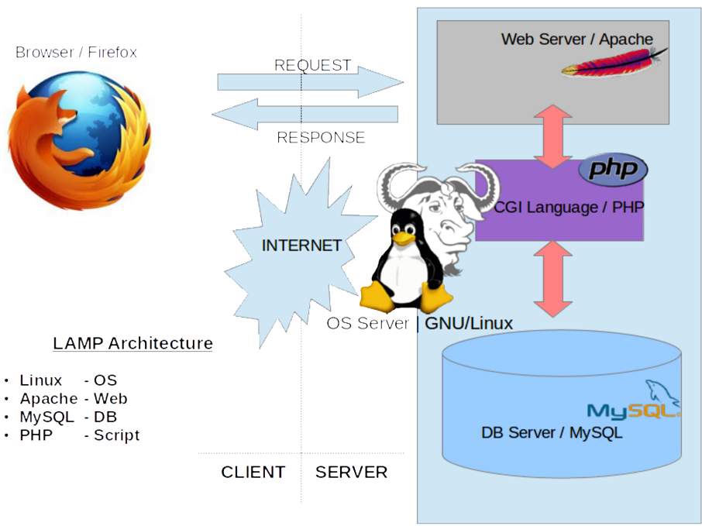
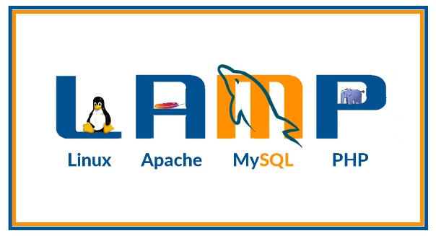
Popular Stacks
Notes:
Slide contains animations.

Slide 27
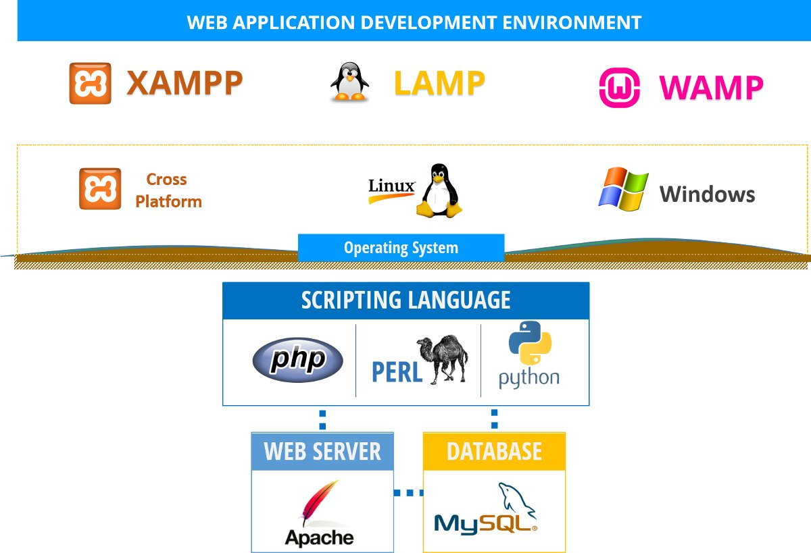
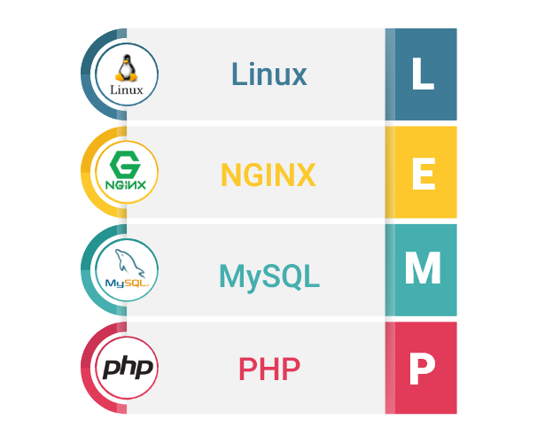
Popular Stacks
Notes:
Slide contains animations.

Slide 28
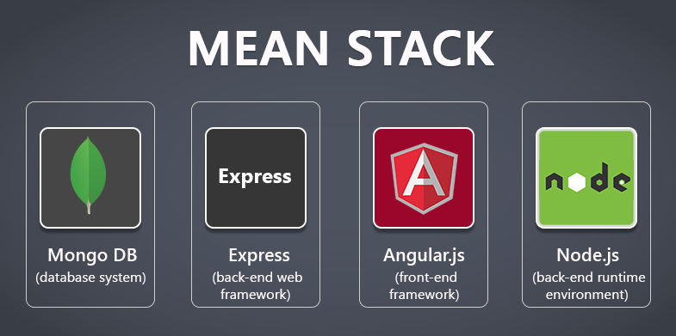
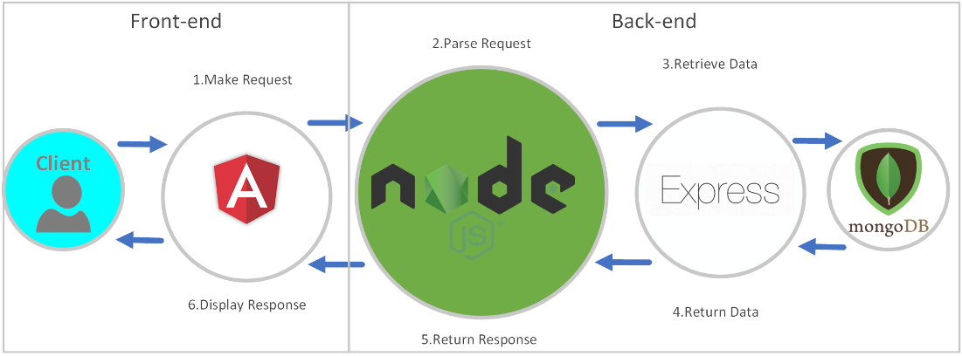
Popular Stacks
Notes:
Slide contains animations.

Slide 29
App Service on Linux Architecture

Slide 30

Module Objective
Understand how App Service on Linux is implemented.
Notes:
Slide contains animations.

Slide 31

Video: Web Apps on Linux
Watch this video with the class and discuss the main topics presented:
Internal Configuration of MegaStamp as virtual network.
Primary Stamp and Linux Stamp.
Request Flow.
https://microsoft.sharepoint.com/:f:/t/AppsInfraReadinessCouncil/EvPxvrF76etLjOSwt_GWOIMBFJkPmSa4VzliJtOEYkKvpw?e=Ah2mmJ
Notes:
Video length 6 minutes

Slide 32
Nginx

Slide 33

Module Objective
Explain how routing is passed from the frontend using Nginx.
Notes:
Slide contains animations.

Slide 34
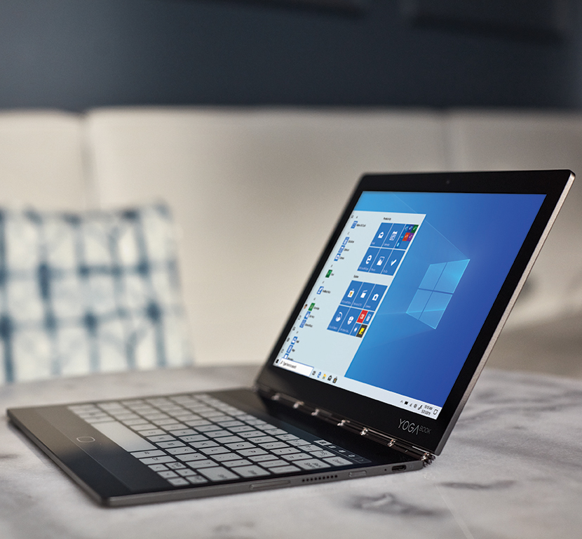
Nginx
Nginx is an open source web server and reverse proxy which is lightweight and versatile.
Load-balancing, caching, and SSL encryption are features that are included as well.
On Azure App Services on Linux, the software is used as a reverse proxy to route requests from our front-end servers to the customers application.
Some of our Docker images also include Nginx as a web server.

Slide 35
Nginx Reverse Proxy
A reverse proxy is used to route requests between one server to another.
The requests are intercepted and then forwarded based on routes specified in the configurations.
An example of a typical Nginx reverse proxy configuration can be seen below.
This Nginx reverse proxy is configured with the following:
Domain name of "www.example.com "
Listens on port 443 for requests.
Path to self-signed SSL certificate.
Allowed SSL ciphers/protocols.
A location directive for specifying "/". This means that the rule will apply to all requests.
The proxy_pass with the server to route the request to.
server {
listen 443 ssl;
server_name www.example.com;
ssl_certificate /etc/ssl/certs/nginx-selfsigned.crt;
ssl_certificate_key /etc/ssl/private/nginx-selfsigned.key;
ssl_protocols TLSv1 TLSv1.1 TLSv1.2;
ssl_ciphers HIGH:!aNULL:!MD5;
location / {
proxy_pass http://localhost:4000/;
}

Slide 36

Proxy Buffering
Nginx buffers responses by default which helps with performance for slow clients.
This can, however, waste server time if the response is passed synchronously from Nginx to the client.
Users can modify the buffers by using the following directives.
proxy_buffers
proxy_buffer_size
location /some/path/ {
proxy_buffers 16 4k;
proxy_buffer_size 2k;
proxy_pass http://localhost:8000;
}

Slide 37
App Service on Linux vs. Web App for Containers

Slide 38

Module Objective
Understand Blessed Images and Custom Containers.
Notes:
Slide contains animations.

Slide 39
Azure App Service on Linux
Azure App Service is a fully managed compute platform that is optimized for hosting websites and web applications. Customers can use App Service on Linux to host web apps natively on Linux for supported application stacks.
App Service on Linux supports a number of Built-in images in order to increase developer productivity. Languages include: Node.js, Java (JRE 8 & JRE 11), PHP, Python, .NET Core and Ruby. Run az webapp list-runtimes --linux to view the latest languages and supported versions.
If the runtime your application requires is not supported in the built-in images, there are instructions on how to build your own Docker image to deploy to Web App for Containers.
Deployments of Azure App Service can be listed below:
GitHub
Bitbucket
Local Git
FTP
Notes:
Slide contains animations.

Slide 40
Web App for Containers
Web App for Containers is catered more towards developers who want to have more control over, not just the code, but also the different packages, runtime framework, tooling etc. that are installed on their containers.
This offering is essentially bringing years worth of Azure App Service PaaS innovations to the community, by allowing developers to just focus on composing their containers without worrying about managing and maintaining an underlying container orchestrator.
Customers of this offering prefer to package their code and dependencies into containers using various CI/CD systems like:
Jenkins
Maven
Travis CI
Azure DevOps
Notes:
Slide contains animations.

Slide 41

Video: Web App for Containers
Watch this video with the class and discuss the main topics presented:
Manage Web App on Azure Platform
Integration
Security and Control
https://microsoft.sharepoint.com/:f:/t/AppsInfraReadinessCouncil/EvPxvrF76etLjOSwt_GWOIMBFJkPmSa4VzliJtOEYkKvpw?e=Ah2mmJ
Notes:
Video length 1 minute

Slide 42
Web App for Containers-Multi Container

Slide 43

Module Objective
Understand Docker Compose and how Multi Container works.
Notes:
Slide contains animations.

Slide 44
Simulation: Create Multi Container in Web App
Open your Participant Guide.
Review the information provided.
Create Multi Container in Web App, following the instructions.

Slide 45
Resources – Part 1
Linux Distributions Provided on Azure
https://docs.microsoft.com/en-us/azure/virtual-machines/linux/endorsed-distros
Linux VM's Access
https://docs.microsoft.com/en-us/azure/marketplace/cloud-partner-portal/virtual-machine/cpp-connect-vm#connect-to-a-linux-based-vm
Linux OS's Common Commands
https://supportability.visualstudio.com/AzureAppService/_wiki/wikis/AzureAppService/188482/Azure-App-Service-Linux-Perf?anchor=commands
File System Structure
https://supportability.visualstudio.com/AzureAppService/_wiki/wikis/AzureAppService/188482/Azure-App-Service-Linux-Perf?anchor=system-structure-%26-directories
Best Practices for Docker Container
https://supportability.visualstudio.com/AzureAppService/_wiki/wikis/AzureAppService/188332/Azure-App-Service-Containers-Docker-Containers?anchor=docker-best-practices

Slide 46
Resources – Part 2
Open Source Stacks
https://supportability.visualstudio.com/AzureAppService/_wiki/wikis/AzureAppService/188476/Azure-App-Service-Linux-OSS
App Service on Linux Architecture
https://microsoft.sharepoint.com/teams/DSHome/azure/WAWS/Shared%20Documents/Training/Videos/Web%20Apps%20on%20Linux.mp4
Nginx
https://supportability.visualstudio.com/AzureAppService/_wiki/wikis/AzureAppService/293750/Azure-App-Service-Linux-Nginx
App Service on Linux (Blessed Images) vs Web App for Containers (Custom Containers)
https://docs.microsoft.com/en-us/azure/app-service/containers/app-service-linux-intro
https://azure.microsoft.com/en-us/blog/webapp-for-containers-overview/
https://azure.microsoft.com/en-us/services/app-service/containers/
Web App for Containers – Multi Container
https://docs.microsoft.com/en-us/azure/app-service/containers/tutorial-multi-container-app

Slide 47
Thank you!

